Slide 1


Resting-state functional changes across mood states of
bipolar disorder
Peking University Sixth Hospital
Reporter：Yan-Kun Wu
supervisor：Yun-Ai Su

Slide 2

CONTENTS
01
02
03
04
Background
Results
Methods
Conclusions

Slide 3
CONTENTS
01
02
03
04
Background
Results
Methods
Conclusions

Slide 4
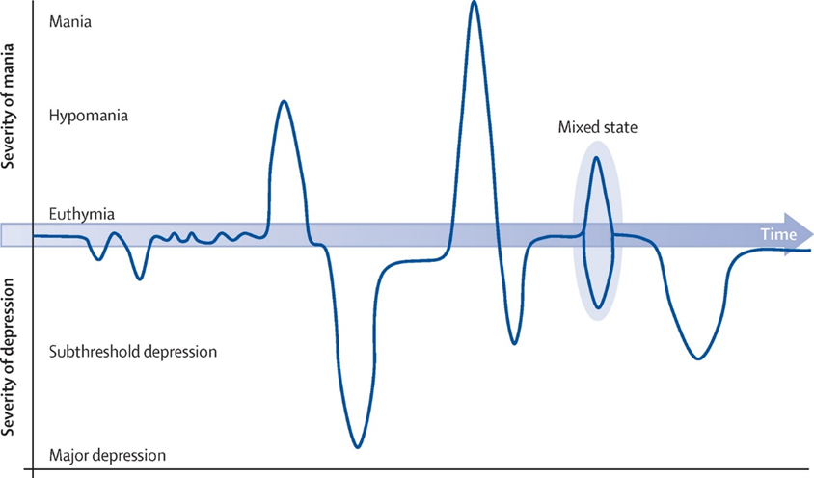
Bipolar disorder: poor understanding of pathophysiology
BD, also known as manic-depressive illness, is a chronic, relapsing mental health condition typically characterized by episodes of depression and episodes of mania or hypomania.
BD affects approximately 2% of U.S. adults.
Weighted lifetime prevalence of bipolar disorders in China is 0.6%.
The pathophysiology underlying such differences in mood states remains unclear.
Yueqin Huang et al., Lancet psychiatry, 2019
Mark S. Bauer, Annals of Internal Medicine, 2022
Iria Grande et al., Lancet.2016
Notes:
Bipolar disorder is a recurrent chronic disorder characterised by fluctuations in mood state and energy
understanding of the pathophysiology underlying such differences in mood states could not only aid in understanding how acute mood episodes develop at a neurophysiological level but also provide biological targets for personalized treatment and development of new interventions for bipolar disorder

Slide 5
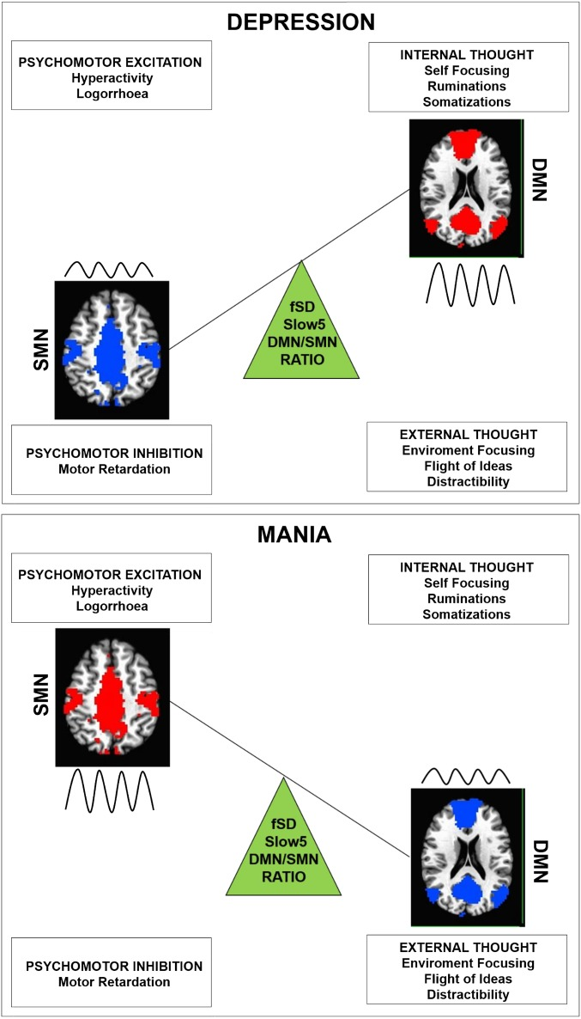
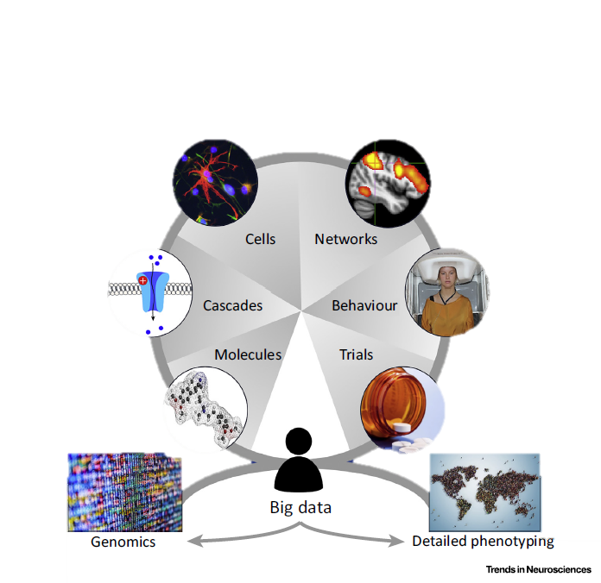
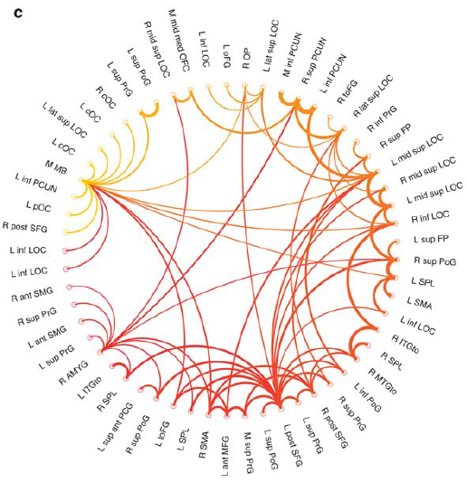
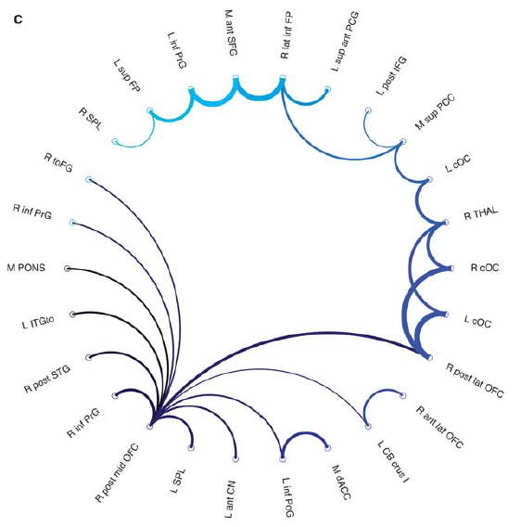
Current findings from fMRI studies
Martino M et al., PNAS., 2016
Jeffrey M Spielberg et al., Neuropsychopharmacology, 2016
Paul J. Harrisonet al., Trends Neurosci, 2018

Slide 6
CONTENTS
01
02
03
04
Background
Results
Methods
Conclusions

Slide 7
Methods
VN, visual network; SMN, sensorimotor network; DAN, dorsal attention network; VAN, ventral attention network; SCN, subcortical network; FPN, frontoparietal network; DMN, default mode network; BDM, (hypo)manic BD patients; BDD, depressive BD patients; BDE, euthymic BD patients; HC, healthy control.

Slide 8
CONTENTS
01
02
03
04
Background
Results
Methods
Conclusions

Slide 9
Demographic and clinical information
M (SD), mean (standard deviation); FD, framewise displacement; HRSD, Hamilton Depression Scale-17; YMRS, Young Mania Rating Scale; PANAS, The Positive and Negative Affect Schedule; PANAS-PA, positive affect subscale of PANAS; PANAS-NA, negative affect subscale of PANAS

Slide 10
Mania/hypomania exhibited increased network FCs

Slide 11
Demographic and clinical information

Slide 12
DMN-VAN FC exhibited group-to-individual generalizability
Based on Shaeffer’s 400 atlas
Based on Dosenbach’s 160 atlas

Slide 13
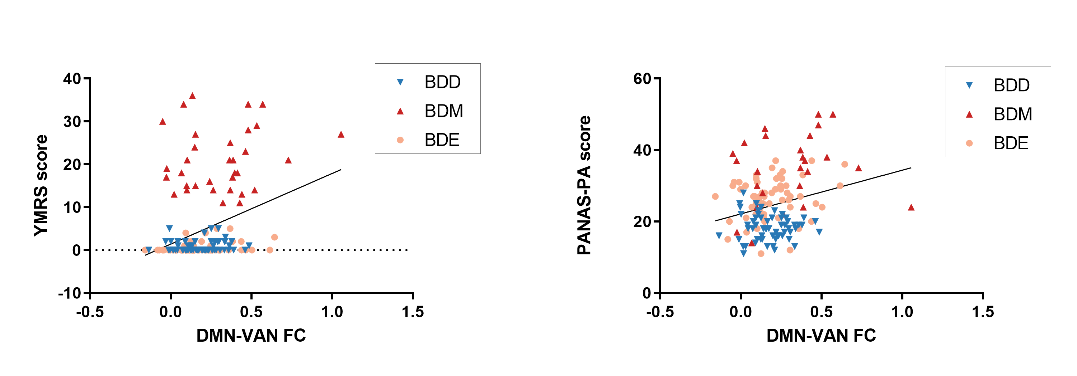
Correlation between symptom scores and network FC
r = 0.32
p < 0.001
r = 0.25
p = 0.002

Slide 14
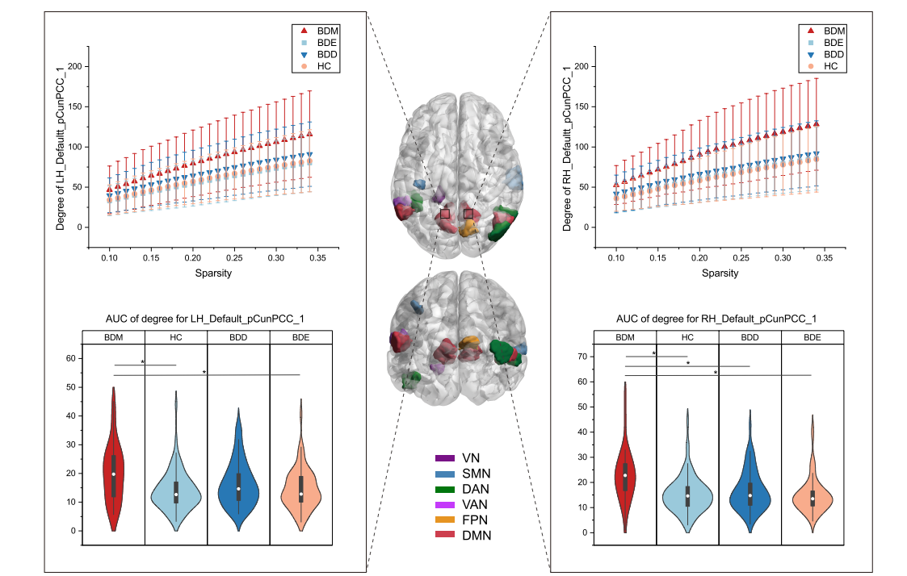
Several brain regions exhibited higher degree in BDM
LH_VAN_Parietal operculum
RH_FPN_Precuneus
Bilateral_Visual network
Bilateral_Somatomotor network
Bilateral_DAN_Posterior
Bilateral_DMN_Parietal
Bilateral_DMN_Precuneus/posterior cingulate cortex
Notes:
We observed 16 brain regions showed significant between-group differences in comparison of degree. However, no region showed significant between-group differences in betweenness centrality.

Slide 15
CONTENTS
01
02
03
04
Background
Results
Methods
Conclusions

Slide 16
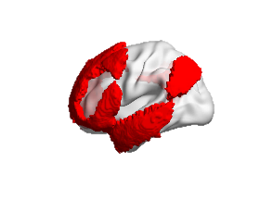
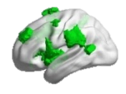
Conclusions
BDM exhibited extensive increased between-network FCs in the VN, the SCN and the DMN.
Patients in mania/hypomania state exhibited increased DMN-VAN FC.
The between-network FCs that showed significant between-group differences was positively correlated with the manic symptoms.
The precuneus/posterior cingulate cortex may be a hub in shifts between mood states in bipolar disorder.

Slide 17
Thanks
Reporter：Yan-Kun Wu
supervisor：Yun-Ai Su

